Slide 1
Staging Experiences

Slide 2
“The Experience Economy”
Levels of Market Offering:
  Commodity
  Good (Product)
  Service
  Experience

Slide 3
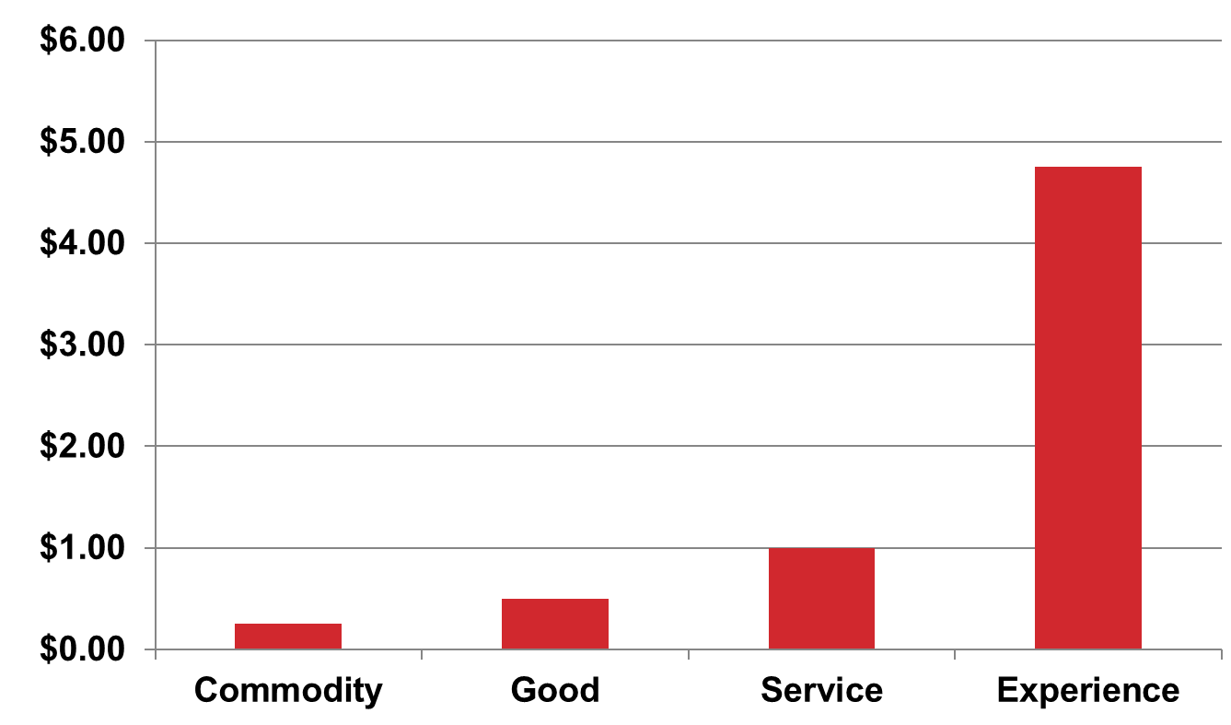
Example: Price of Coffee Offerings

Slide 4
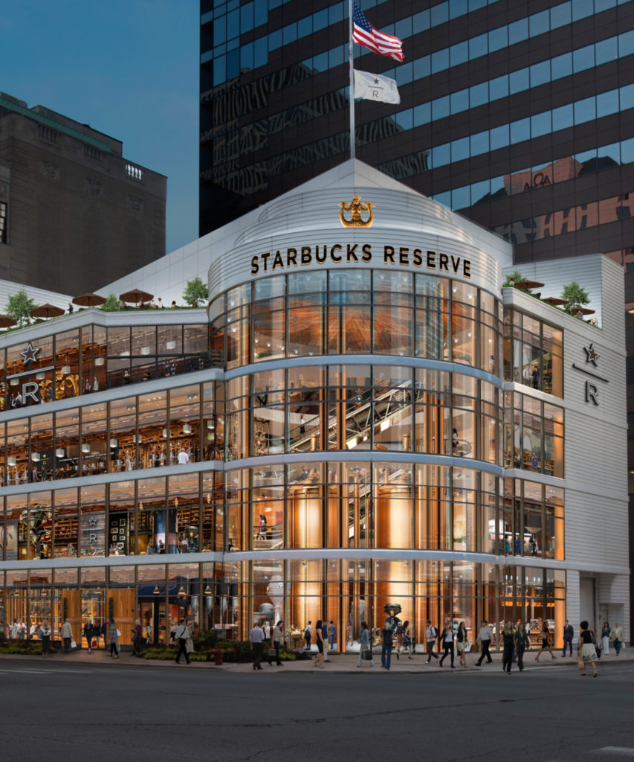
Starbucks Reserve Roastery

Slide 5
Levels of Customer Value-Add
Core product/service benefits
Expected benefits
Augmented benefits
Experience!

Slide 6
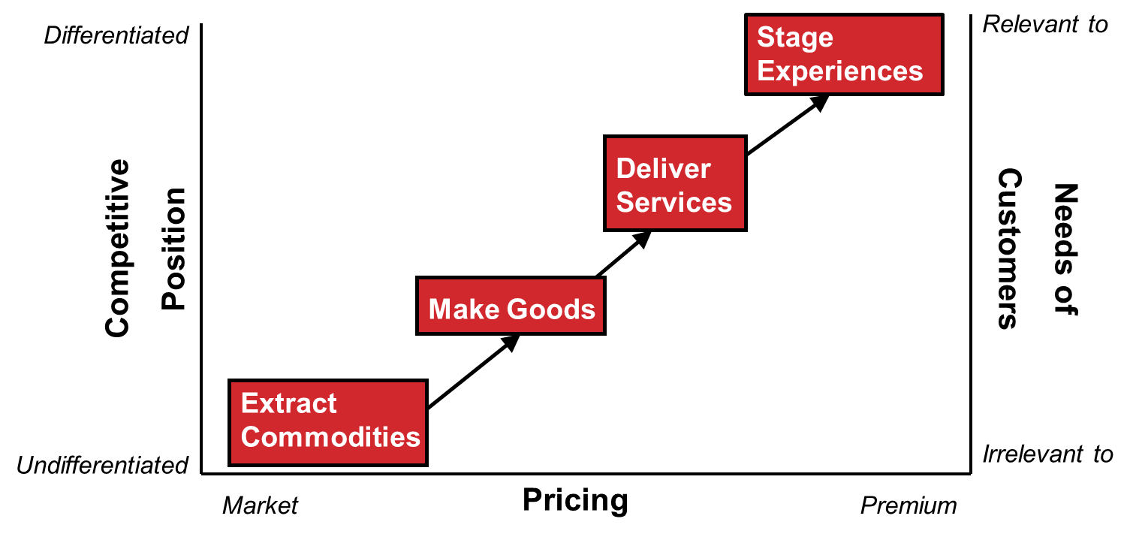
Progression of Economic Value

Slide 7
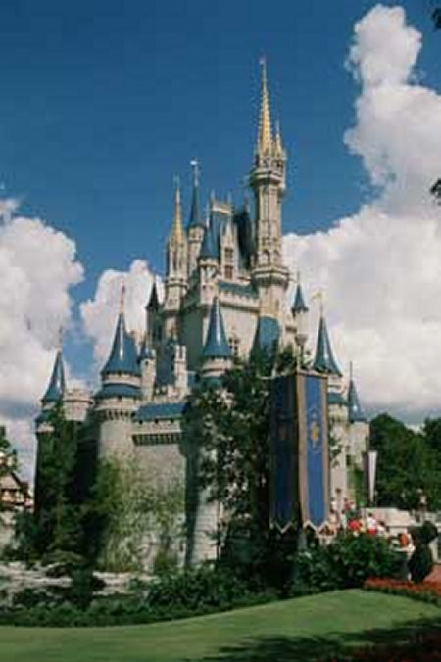
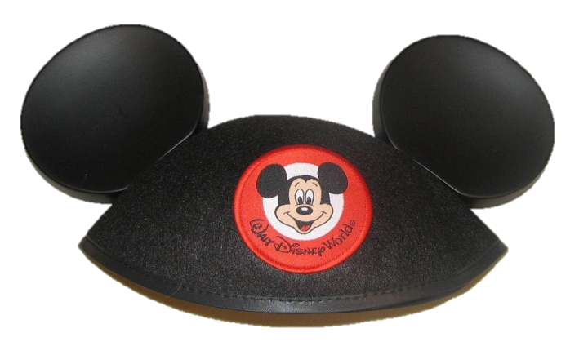
Designing Memorable Experiences
Theme the experience
Harmonize impressions with positive cues
Eliminate negative cues
Mix in memorabilia
Engage all five senses

Slide 8
Traditional Marketing versus Experiential Marketing
Traditional:
Features & benefits
Narrowly defined categories
“Rational” consumers
Experiential:
Focus on customer experiences
Focus on consumption situation
Emotional/rational consumers

Slide 9
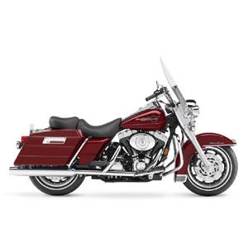
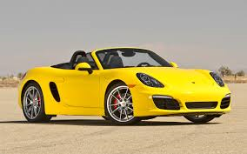
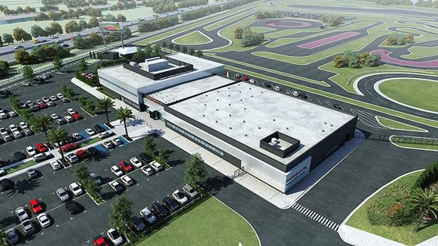

Even Products Can be Experiences

Slide 10

Charmin Van-Go On-Demand Private Restroom

Slide 11
Conclusion
Where is your firm operating on the commodity—good—service—experience continuum?
How can your firm “stage experiences” for your customers?

Slide 12
End of Lecture

